Slide 1
Learning Conjunctions
There is a hidden conjunctions the learner is to learn
The number of conjunctions:
log(|C|) = n
The elimination algorithm makes n mistakes
Learn from positive examples; eliminate active literals.
k-conjunctions:
Assume that only k<<n attributes occur in the disjunction
The number of k-conjunctions:
log(|C|) =
Can we learn efficiently with this number of mistakes ?
What’s possible?
Last time:
Learning Protocols
Exact (vs. in exact) Learning
On Line Learning
# of examples needed to learn
# of mistakes needed to learn
Developed ideas on what might be possible (finite hypothesis classes)
Can mistakes be bounded in the non-finite case?
Can this bound be achieved?

Slide 2
Representation
Assume that you want to learn conjunctions. Should your hypothesis space be the class of conjunctions?
Theorem: Given a sample on n attributes that is consistent with a conjunctive concept, it is NP-hard to find a pure conjunctive hypothesis that is both consistent with the sample and has the minimum number of attributes.
[David Haussler, AIJ’88: “Quantifying Inductive Bias: AI Learning Algorithms and Valiant's Learning Framework”]
Same holds for Disjunctions.
Intuition: Reduction to minimum set cover problem.
Given a collection of sets that cover X, define a set of examples so that learning the best (dis/conj)junction implies a minimal cover.
Consequently, we cannot learn the concept efficiently as a (dis/con)junction.
But, we will see that we can do that, if we are willing to learn the concept as a Linear Threshold function.
In a more expressive class, the search for a good hypothesis sometimes becomes combinatorially easier.
Importance of Representation

Slide 3
Linear Functions
{
1 if w1 x1 + w2 x2 +. . . wn xn >= θ
0 Otherwise
f (x) =
Disjunctions
At least m of n:
Exclusive-OR:
Non-trivial DNF
y = x1 ∨ x3 ∨ x5
y = ( 1• x1 + 1• x3 + 1• x5 >= 1)
y = at least 2 of {x1 , x3 , x5}
y = ( 1• x1 + 1• x3 + 1• x5 >=2)
Linear Functions
y = (x1 Λ x2 v ) (x1 Λ x2)
y = (x1 Λ x2) v (x3 Λ x4)

Slide 4
w ¢ x = θ
-
-
-
-
-
-
-
-
-
-
-
-
-
-
w ¢ x = 0
-

Slide 5
Footnote About the Threshold
On previous slide, Perceptron has no threshold
But we don’t lose generality:

Slide 6
Perceptron learning rule
On-line, mistake driven algorithm.
Rosenblatt (1959) suggested that when a target output value is provided for a single neuron with fixed input, it can incrementally change weights and learn to produce the output using the Perceptron learning rule
(Perceptron == Linear Threshold Unit)
Perceptron
1
2
7
T
3
4
5
6

Slide 7
Perceptron learning rule
Mistake driven algorithms
Analysis via mistake bound
Can mistakes be bounded in the non-finite case?
Can we achieve good bounds?
We learn f:X→{-1,+1} represented as f =sgn{w•x)
Where X= {0,1}^{n} or X= R^{n} and w∈ R^{n}
Given Labeled examples: {(x₁, y₁), (x₂, y₂),…(x_{m}, y_{m})}
Initialize w=0∈
2. Cycle through all examples
a. Predict the label of instance x to be y’ = sgn{w•x)
b. If y’≠y, update the weight vector:
w = w + r y x (r - a constant, learning rate)
Otherwise, if y’=y, leave weights unchanged.
Perceptron

Slide 8
The Perceptron rule
If y = +1: x should be above the decision boundary
Raise the decision boundary’s slope: w^{i+1} := w^{i} + x
If y = -1: x should be below the decision boundary Lower the decision boundary’s slope: w^{i+1} := w^{i} – x
Target
Previous Model
New Model
x
x
x
Target
Previous Model
New Model
x
x
x

Slide 9
Perceptron in action
x (with y = +1)
next item to be classified
x as a vector
wx = 0
New decision boundary
wx = 0
Current decision boundary
w Current weight vector
w New weight vector
x as a vector added to w
Positive
(Figures from Bishop 2006)
Negative

Slide 10
Perceptron in action
wx = 0
New decision boundary
x (with y = +1)
next item to be classified
x as a vector
wx = 0
Current decision boundary
w Current weight vector
x as a vector added to w
w New weight vector
Positive
(Figures from Bishop 2006)
Negative

Slide 11
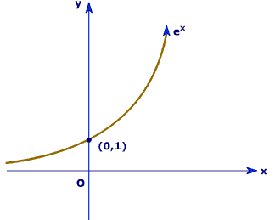
Perceptron learning rule
If x is Boolean, only weights of active features
are updated
Why is this important?
Initialize w=0∈
2. Cycle through all examples
a. Predict the label of instance x to be y’ = sgn{w•x)
b. If y’≠y, update the weight vector to
w = w + r y x (r - a constant, learning rate)
Otherwise, if y’=y, leave weights unchanged.
Perceptron

Slide 12
Perceptron Learnability
Obviously can’t learn what it can’t represent (???)
Only linearly separable functions
Minsky and Papert (1969) wrote an influential book demonstrating Perceptron’s representational limitations
Parity functions can’t be learned (XOR)
In vision, if patterns are represented with local features, can’t represent symmetry, connectivity
Research on Neural Networks stopped for years
Rosenblatt himself (1959) asked,
“What pattern recognition problems can be transformed so as to become linearly separable?”
Perceptron

Slide 13
(x1 Λ x2) v (x3 Λ x4)
y1 Λ y2

Slide 14
Perceptron Convergence
Perceptron Convergence Theorem:
If there exist a set of weights that are consistent with the data (i.e., the data is linearly separable), the perceptron learning algorithm will converge
How long would it take to converge ?
Perceptron Cycling Theorem:
If the training data is not linearly separable the perceptron learning algorithm will eventually repeat the same set of weights and therefore enter an infinite loop.
How to provide robustness, more expressivity ?
Perceptron

Slide 15
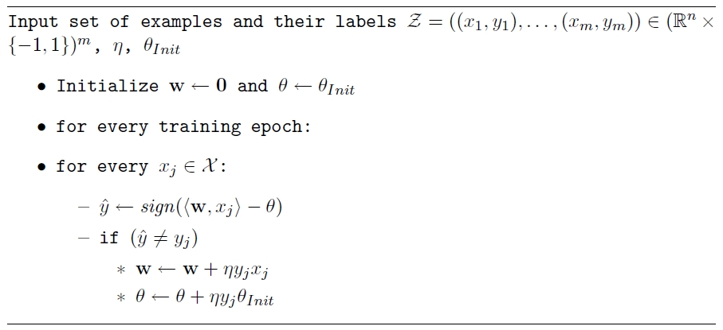
Perceptron
Just to make sure we understand
that we learn both w and µ

Slide 16
Perceptron: Mistake Bound Theorem
Maintains a weight vector w∈R^{N}, w₀=(0,…,0).
Upon receiving an example x ∈ R^{N}
Predicts according to the linear threshold function w•x ≥ 0.
Theorem [Novikoff,1963] Let (x₁; y₁),…,: (x_{t}; y_{t}), be a sequence of labeled examples with x_{i} ∈<^{N}, ||x_{i}||≤R and y_{i} ∈{-1,1} for all i. Let u∈ <^{N}, γ > 0 be such that, ||u|| = 1 and y_{i} u • x_{i} ≥ γ for all i.
Then Perceptron makes at most R² / γ ² mistakes on this example sequence.
(see additional notes)
Analysis
Complexity Parameter

Slide 17
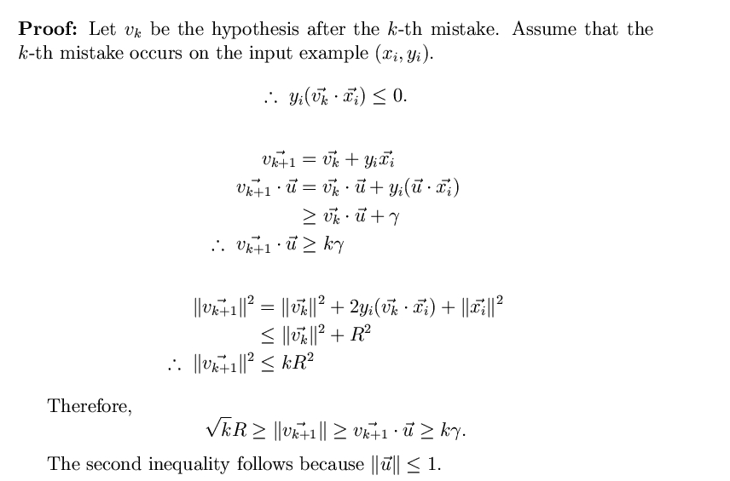
Perceptron-Mistake Bound
Proof: Let v_{k} be the hypothesis before the k-th mistake. Assume that the k-th mistake occurs on the input example (x_{i}, y_{i}).
Assumptions
v₁ = 0
||u|| = 1
y_{i} u • x_{i} ≥ γ
Note that the bound does not
depend on the dimensionality
nor on the number of examples.
Note that we place weight vectors
and examples in the same space.
k < R² / γ ²
Notes:
Second inequality: u\cdot v = ||u|| ||v|| cos(u,v) <=||u|| ||v|| <= ||v||

Slide 18
Robustness to Noise
In the case of non-separable data , the extent to which a data point fails to have margin ° via the hyperplane w can be quantified by a slack variable
»_{i}= max(0, ° − y_{i} w¢ x_{i}).
Observe that when »_{i} = 0, the example x_{i} has margin at least °. Otherwise, it grows linearly with − y_{i} w¢ x_{i}
Denote: D₂ = [∑ {»_{i}²}]^{1/2}
Theorem: The perceptron is
guaranteed to make no more than
((R+D₂)/°)² mistakes on any sequence
of examples satisfying ||x_{i}||²<R
Perceptron is expected to
have some robustness to noise.
Non separable
case
-
-
-
-
-
-
-
-
-
-
-
-
-
-
-
Notes:
Need to understand \xi :
The interpretation of the theorem (as well as the Perceptron in the separable case): there is a sequence of examples satisfying these conditions; on this sequence of examples (irrespective of its size and irrespective of its dimensionality) this is the bound on the number of mistakes.

Slide 19
Perceptron for Boolean Functions
How many mistakes will the Perceptron algorithms make when learning a k-disjunction?
Try to figure out the bound
Find a sequence of examples that will cause Perceptron to make O(n) mistakes on k-disjunction on n attributes.
(Where is n coming from?)
Perceptron

Slide 20
Winnow Algorithm
The Winnow Algorithm learns Linear Threshold Functions.
For the class of disjunctions:
instead of demotion we can use elimination.
Winnow

Slide 21
Winnow - Example
Notice that the same algorithm will learn a conjunction over these variables (w=(256,256,0,…32,…256,256) )

Slide 22
Winnow – Mistake Bound
Claim: Winnow makes O(k log n) mistakes on k-disjunctions
u - # of mistakes on positive examples (promotions)
v - # of mistakes on negative examples (demotions)
u < k log(2n)
A weight that corresponds to a good variable is only promoted.
When these weights get to n there will be no more mistakes on positives.
Analysis

Slide 23
Winnow – Mistake Bound
Claim: Winnow makes O(k log n) mistakes on k-disjunctions
u - # of mistakes on positive examples (promotions)
v - # of mistakes on negative examples (demotions)
2. v < 2(u + 1)
Total weight TW=n initially
Mistake on positive: TW(t+1) < TW(t) + n
Mistake on negative: TW(t+1) < TW(t) - n/2
0 < TW < n + u n - v n/2 ⇒ v < 2(u+1)
Analysis
Notes:
Note that, independent of the round of update:
- if you made a mistake on a positive example, your current total weight is less than n (otherwise, it wouldn’t have been a mistake), and
- If you made a mistake on a negative example (you thought it was positive) your current total weight is more than n, for the same reason, so if I subtract n/2 I am still larger than the new TW.

Slide 24
Winnow – Mistake Bound
Claim: Winnow makes O(k log n) mistakes on k-disjunctions
u - # of mistakes on positive examples (promotions)
v - # of mistakes on negative examples (demotions)
# of mistakes: u + v < 3u + 2 = O(k log n)
Winnow

Slide 25
Summary of Algorithms
Examples: x 2 {0,1}^{n}; or x 2 R^{n} (indexed by k) ; Hypothesis: w 2 R^{n}
Prediction: y 2{-1,+1}: Predict: y = 1 iff w¢ x >µ
Update: Mistake Driven
Additive weight update algorithm: w Ã w +r y_{k} x_{k}
(Perceptron, Rosenblatt, 1958. Variations exist)
In the case of Boolean features:
Multiplicative weight update algorithm w_{i} Ã w_{i} exp{y_{k} x_{i}}
(Winnow, Littlestone, 1988. Variations exist)
Boolean features:
Perceptron & Winnow

Slide 26
Practical Issues and Extensions
There are many extensions that can be made to these basic algorithms.
Some are necessary for them to perform well
Regularization (next; will be motivated in the next section, COLT)
Some are for ease of use and tuning
Converting the output of a Perceptron/Winnow to a conditional probability
P(y = +1 |x) = [1+ exp(-Awx)]⁻¹
Can tune the parameter A
Multiclass classification (later)
Key efficiency issue: Infinite attribute domain
Extensions

Slide 27
Conditional Probabilities
Plotting: For example z:
y = Prob(label=1 | f(z)=x)
(Histogram: for 0.8, # (of examples
with f(z)<0.8))
Claim: Yes; If Prob(label=1 | f(z)=x) = x
Then f(z) = f(z) is a probability dist.
That is, yes, if the graph is linear.
Theorem: Let X be a RV with
distribution F.
F(X) is uniformly distributed in (0,1).
If U is uniform(0,1), F⁻¹(U) is
distributed F, where F⁻¹(x) is the value
of y s.t. F(y) =x.
Alternatively:
f(z) is a probability if: Prob_{U} {z| Prob[(f(z)=1 · y]} = y
Plotted for SNoW (Winnow). Similarly, perceptron; more tuning is required for SVMs.

Slide 28
I Regularization Via Averaged Perceptron
An Averaged Perceptron Algorithm is motivated by the following considerations:
Every Mistake-Bound Algorithm can be converted efficiently to a PAC algorithm – to yield global guarantees on performance.
In the mistake bound model:
We don’t know when we will make the mistakes.
In the PAC model:
Dependence is on number of examples seen and not number of mistakes.
Which hypothesis will you choose…??
Being consistent with more examples is better
To convert a given Mistake Bound algorithm (into a global guarantee algorithm):
Wait for a long stretch w/o mistakes (there must be one)
Use the hypothesis at the end of this stretch.
Its PAC behavior is relative to the length of the stretch.
Averaged Perceptron returns a weighted average of a number of earlier hypotheses; the weights are a function of the length of no-mistakes stretch.
Averaged Perceptron
Notes:
Assume that you are hoping to see a stretch of 1000 examples, with no mistakes; if you see that, you know that the algorithm is good enough. (to be justified when we talk about PAC).
And assume that your mistake bound algorithm has a bound of 500.
The worst scenario is that you go 999 examples, almost happy, but then you see a mistake; so you start again; see 999 examples, and another mistake; and so on. But this can happen at most 500 times. After that, you will get as long a stretch as you want.

Slide 29
I Regularization Via Averaged Perceptron (or Winnow)
Training:
[m: #(examples); k: #(mistakes) = #(hypotheses); c_{i}: consistency count for v_{i} ]
Input: a labeled training set {(x₁, y₁),…(x_{m}, y_{m})}
Number of epochs T
Output: a list of weighted perceptrons {(v₁, c₁),…,(v_{k}, c_{k})}
Initialize: k=0; v₁ = 0, c₁ = 0
Repeat T times:
For i =1,…m:
Compute prediction y’ = sign(v_{k} ¢ x_{i} )
If y’ = y, then c_{k} = c_{k} + 1
else: v_{k+1} = v_{k} + y_{i} x ; c_{k+1} = 1; k = k+1
Prediction:
Given: a list of weighted perceptrons {(v₁, c₁),…(v_{k}, c_{k})} ; a new example x
Predict the label(x) as follows:
y(x)= sign [ ∑_{1, k} c_{i} sign(v_{i} ¢ x) ]
Averaged Perceptron

Slide 30
II Perceptron with Margin
Thick Separator (aka as Perceptron with Margin) (Applies both for Perceptron and Winnow)
Promote if:
w x - θ < γ
Demote if:
w x - θ > γ
w ¢ x = θ
-
-
-
-
-
-
-
-
-
-
-
-
-
-
w ¢ x = 0
-
Note: γ is a functional margin. Its effect could disappear as w grows.
Nevertheless, this has been shown to be a very effective algorithmic addition.
(Grove & Roth 98,01; Karov et. al 97)

Slide 31
Other Extensions
Threshold relative updating (Aggressive Perceptron)
Equivalent to updating
on the same example
multiple times
Notes:
Derive the update rule by requiring that w’x > \theta; that is (w+rx) x > \theta

Slide 32
SNoW (also in LBJava)
Several of these extensions (and a couple more) are implemented in the SNoW learning architecture that supports several linear update rules (Winnow, Perceptron, naïve Bayes)
Supports
Regularization(averaged Winnow/Perceptron; Thick Separator)
Conversion to probabilities
Automatic parameter tuning
True multi-class classification
Feature Extraction and Pruning
Variable size examples
Good support for large scale domains in terms of number of examples and number of features.
Very efficient
Many other options
[Download from: http://cogcomp.cs.illinois.edu/page/software ]

Slide 33
Winnow - Extensions
This algorithm learns monotone functions
For the general case:
Duplicate variables (down side?)
For the negation of variable x, introduce a new variable y.
Learn monotone functions over 2n variables
Balanced version:
Keep two weights for each variable; effective weight is the difference
We’ll come back to this idea when talking about multiclass.
Extensions

Slide 34
Winnow – A Robust Variation
Winnow is robust in the presence of various kinds of noise.
(classification noise, attribute noise)
Moving Target:
The target function changes with time.
Importance:
sometimes we learn under some distribution but test under a slightly different one. (e.g., natural language applications)
The algorithm we develop provides a good insight into issues of Adaptation
Extensions

Slide 35
Winnow – A Robust Variation
Modeling:
Adversary’s turn: may change the target concept by adding or removing some variable from the target disjunction.
Cost of each addition move is 1.
Learner’s turn: makes prediction on the examples given, and is then told the correct answer (according to current target function)
Winnow-R: Same as Winnow, only doesn’t let weights go below 1/2
Claim: Winnow-R makes O(c log n) mistakes, (c - cost of adversary) (generalization of previous claim)
Extensions

Slide 36
Winnow R – Mistake Bound
Good project:
Push weights to 0 (simple hypothesis, L1 regularization (Lasso)) vs.
bounding them away from zero
– impact on adaptation
u - # of mistakes on positive examples (promotions)
v - # of mistakes on negative examples (demotions)
2. v < 2(u + 1)
Total weight TW=n initially
Mistake on positive: TW(t+1) < TW(t) + n
Mistake on negative: TW(t+1) < TW(t) - n/4
0 < TW < n + u n - v n/4 ⇒ v < 4(u+1)
Extensions
Notes:
Difference: if we make a mistake on a negative example, we thought it was positive, so the total weight is larger than n. But n/2 of it is safe, since I cannot cut the weights below ½, so it’s possible that I will only reduce the total weight by half of the remaining n/2. So if I am removing n/4, and am still above the new TW.

Slide 37
Administration
TODAY:
Administration: HW, Projects
Flipped Class
Continuing with On-Line Learning
Questions
Registration - Done
Hw2 is due tomorrow
Hw3 will be released tomorrow

Slide 38
HW2
Decision Trees, Expressivity of Models, Features
Key Reporting Module (RM):
Train a model on a given Training Set
Report 5-fold cross validation
Report results on a supplied Test Set.
(a) Convert Data to Feature Representation (given; can be augmented)
2000 * 270 dimensions
(b) Program SGD; run RM
(c) Use Weka to Learn DT using ID2; run RM.
(d) Use Weka to learn DT(depth=4) and DT(depth=8); run RM
(e) Use Weka to generate 100 different DT(d=4)
Generate 100 dimensional data, each dimension is the prediction of a DT
Run (b) on the new data
Compare algorithms from b,c,d,e.
Stopping Criterion left ambiguous deliberately. Multiple options; think and make a decision (e.g., based on loss; based on error).
Features; feature types; instances space transformation.

Slide 39
Projects
Projects proposals are due on March 10 2017
Within a week we will give you an approval to continue with your project along with comments and/or a request to modify/augment/do a different project. There will also be a mechanism for peer comments.
We encourage team projects – a team can be up to 3 people.
Please start thinking and working on the project now.
Your proposal is limited to 1-2 pages, but needs to include references and, ideally, some of the ideas you have developed in the direction of the project (maybe even some preliminary results).
Any project that has a significant Machine Learning component is good.
You can do experimental work, theoretical work, a combination of both or a critical survey of results in some specialized topic.
The work has to include some reading. Even if you do not do a survey, you must read (at least) two related papers or book chapters and relate your work to it.
Originality is not mandatory but is encouraged.
Try to make it interesting!

Slide 40
Examples
Fake News Challenge :- http://www.fakenewschallenge.org/
KDD Cup 2013:
"Author-Paper Identification": given an author and a small set of papers, we are asked to identify which papers are really written by the author.
https://www.kaggle.com/c/kdd-cup-2013-author-paper-identification-challenge
“Author Profiling”: given a set of document, profile the author: identification, gender, native language, ….
Caption Control: Is it gibberish? Spam? High quality text?
Adapt an NLP program to a new domain
Work on making learned hypothesis (e.g., linear threshold functions, NN) more comprehensible
Explain the prediction
Develop a (multi-modal) People Identifier
Compare Regularization methods: e.g., Winnow vs. L1 Regularization
Large scale clustering of documents + name the cluster
Deep Networks: convert a state of the art NLP program to a deep network, efficient, architecture.
Try to prove something

Slide 41
What have you learned (on your own)
The feasibility of Mistake Bounds
Con
Halving
Perceptron
Algorithms
Perceptron
+ Analysis
Winnow
+ Analysis (special case)
The general case
Algorithms could behave differently
Averaged version of Perceptron/Winnow is as good as any other linear learning algorithm, if not better.
Why do I include Perceptron in this bullet?
What’s interesting about it?

Slide 42

General Stochastic Gradient Algorithms
Given examples {z=(x,y)}_{1, m} from a distribution over XxY, we are trying to learn a linear function, parameterized by a weight vector w, so that we minimize the expected risk function
J(w) = E_{z} Q(z,w) ~=~ 1/m ∑_{1, m} Q(z_{i}, w_{i})
In Stochastic Gradient Descent Algorithms we approximate this minimization by incrementally updating the weight vector w as follows:
w_{t+1} = w_{t} – r_{t} g_{w} Q(z_{t}, w_{t}) = w_{t} – r_{t} g_{t}
Where g_t = g_{w} Q(z_{t}, w_{t}) is the gradient with respect to w at time t.
The difference between algorithms now amounts to choosing a different loss function Q(z, w)

Slide 43
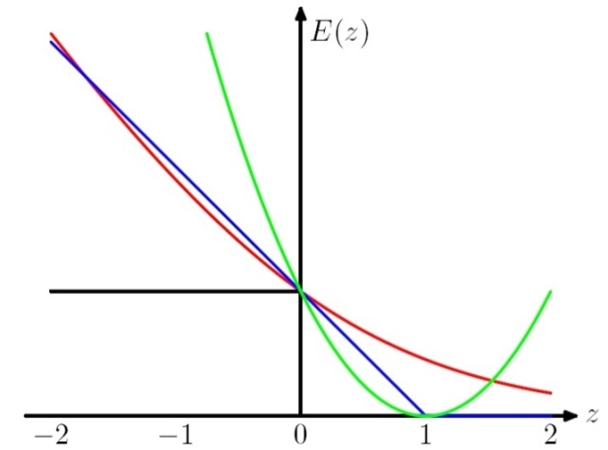
Stochastic Gradient Algorithms
w_{t+1} = w_{t} – r_{t} g_{w} Q(z_{t}, w_{t}) = w_{t} – r_{t} g_{t}
LMS: Q((x, y), w) =1/2 (y – w ¢ x)²
leads to the update rule (Also called Widrow’s Adaline):
w_{t+1} = w_{t} + r (y_{t} – w_{t} ¢ x_{t}) x_{t}
Here, even though we make binary predictions based on sign (w ¢ x) we do not take the sign of the dot-product into account in the loss.
Another common loss function is:
Hinge loss:
Q((x, y), w) = max(0, 1 - y w ¢ x)
This leads to the perceptron update rule:
If y_{i} w_{i} ¢ x_{i} > 1 (No mistake, by a margin): No update
Otherwise (Mistake, relative to margin): w_{t+1} = w_{t} + r y_{t} x_{t}
w ¢ x
Think about the case where x is a Boolean vector.

Slide 44
New Stochastic Gradient Algorithms
w_{t+1} = w_{t} – r_{t} g_{w} Q(z_{t}, w_{t}) = w_{t} – r_{t} g_{t}
(notice that this is a vector, each coordinate (feature) has its own wt,j and gt,j)
So far, we used fixed learning rates r = r_{t}, but this can change.
AdaGrad alters the update to adapt based on historical information, so that frequently occurring features in the gradients get small learning rates and infrequent features get higher ones.
The idea is to “learn slowly” from frequent features but “pay attention” to rare but informative features.
Define a “per feature” learning rate for the feature j, as:
r_{t,j} = r/(G_{t,j})^{1/2}
where G_{t,j} = ∑_{k=1, t} g²_{k,j} the sum of squares of gradients at feature j until time t.
Overall, the update rule for Adagrad is:
w_{t+1,j} = w_{t,j} - g_{t,j} r/(G_{t,j})^{1/2}
This algorithm is supposed to update weights faster than Perceptron or LMS when needed.

Slide 45
Regularization
The more general formalism adds a regularization term to the risk function, and attempts to minimize:
J(w) = ∑_{1, m} Q(z_{i}, w_{i}) + ¸ R_{i} (w_{i})
Where R is used to enforce “simplicity” of the learned functions.
LMS case: Q((x, y), w) =(y – w ¢ x)²
R(w) = ||w||²₂ gives the optimization problem called Ridge Regression.
R(w) = ||w||₁ gives a problem called the LASSO problem
Hinge Loss case: Q((x, y), w) = max(0, 1 - y w ¢ x)
R(w) = ||w||²₂ gives the problem called Support Vector Machines
Logistics Loss case: Q((x,y),w) = log (1+exp{-y w ¢ x})
R(w) = ||w||²₂ gives the problem called Logistics Regression
These are convex optimization problems and, in principle, the same gradient descent mechanism can be used in all cases.
We will see later why it makes sense to use the “size” of w as a way to control “simplicity”.

Slide 46
Algorithmic Approaches
Focus: Two families of algorithms (one of the on-line representative)
Additive update algorithms: Perceptron
SVM is a close relative of Perceptron
Multiplicative update algorithms: Winnow
Close relatives: Boosting, Max entropy/Logistic Regression

Slide 47
How to Compare?
Generalization
(since the representation is the same): How many examples are needed to get to a given level of accuracy?
Efficiency
How long does it take to learn a hypothesis and evaluate it (per-example)?
Robustness; Adaptation to a new domain, ….

Slide 48
Sentence Representation
S= I don’t know whether to laugh or cry
Define a set of features:
features are relations that hold in the sentence
Map a sentence to its feature-based representation
The feature-based representation will give some of the information in the sentence
Use this as an example to your algorithm
Domain Characteristics

Slide 49
Sentence Representation
S= I don’t know whether to laugh or cry
Define a set of features:
features are properties that hold in the sentence
Conceptually, there are two steps in coming up with a feature-based representation
What are the information sources available?
Sensors: words, order of words, properties (?) of words
What features to construct based on these?
Domain Characteristics
Why is this distinction needed?

Slide 50
Embedding
Whether
Weather
New discriminator in functionally simpler

Slide 51
Domain Characteristics
The number of potential features is very large
The instance space is sparse
Decisions depend on a small set of features: the function space is sparse
Want to learn from a number of examples that is
small relative to the dimensionality
Domain Characteristics

Slide 52
Generalization
Dominated by the sparseness of the function space
Most features are irrelevant
# of examples required by multiplicative algorithms depends mostly on # of relevant features
(Generalization bounds depend on the target ||u|| )
# of examples required by additive algoirithms depends heavily on sparseness of features space:
Advantage to additive. Generalization depend on input ||x||
(Kivinen/Warmuth 95).
Generalization

Slide 53
Which Algorithm to Choose?
Generalization
Multiplicative algorithms:
Bounds depend on ||u||, the separating hyperplane; i: example #)
M_{w} =2ln n ||u||₁² max_{i}||x^{(i)}||₁² /min_{i}(u ¢ x^{(i)})²
Do not care much about data; advantage with sparse target u
Additive algorithms:
Bounds depend on ||x|| (Kivinen / Warmuth, ‘95)
M_{p} = ||u||₂² max_{i}||x^{(i)}||₂²/min_{i}(u ¢ x^{(i)})²
Advantage with few active features per example
The l₁ norm: ||x||₁ = ∑_{i}|x_{i}| The l₂ norm: ||x||₂ =(∑₁^{n}|x_{i}|²)^{1/2}
The l_{p} norm: ||x||_{p} = (∑₁^{n}|x_{i}|^{P} )^{1/p} The l₁ norm: ||x||₁ = max_{i}|x_{i}|

Slide 54
Examples
M_{w} =2ln n ||u||₁² max_{i}||x^{(i)}||₁² /min_{i}(u ¢ x^{(i)})²
M_{p} = ||u||₂² max_{i}||x^{(i)}||₂²/min_{i}(u ¢ x^{(i)})²
Extreme Scenario 1: Assume the u has exactly k active features, and the other n-k are 0. That is, only k input features are relevant to the prediction. Then:
||u||₂, = k^{1/2} ; ||u||₁, = k ; max ||x||₂, = n^{1/2 ;}; max ||x||₁, = 1
We get that: M_{p} = kn; M_{w} = 2k² ln n
Therefore, if k<<n, Winnow behaves much better.
Extreme Scenario 2: Now assume that u=(1, 1,….1) and the instances are very sparse, the rows of an nxn unit matrix. Then:
||u||₂, = n^{1/2} ; ||u||₁, = n ; max ||x||₂, = 1 ;; max ||x||₁, = 1
We get that: M_{p} = n; M_{w} = 2n² ln n
Therefore, Perceptron has a better bound.

Slide 55
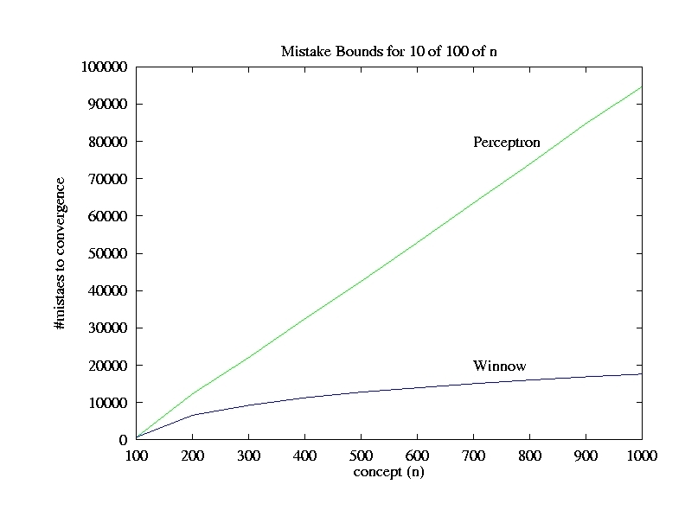
`
Mistakes bounds for 10 of 100 of n
Function: At least 10 out of
fixed 100 variables are active
Dimensionality is n
Perceptron,SVMs
# of mistakes to convergence
Winnow
n: Total # of Variables (Dimensionality)
Notes:
The function is pretty reasonable for cases we are interested in; 10 out of these 100 variables
Should be active. Clearly, linear threshold function. And observe that the multiplicative update algorithm
Scales very nicely; essentially, the total number of variables (n) does not affect that time (number of
Examples) required to learn. This is far from what happens with an additive update algorithm.
This phenomenon will allow us to generate many many potentially plausible features, and learn
On top of them.

Slide 56
Efficiency
Dominated by the size of the feature space
Most features are functions (e.g. conjunctions) of raw attributes
Additive algorithms allow the use of Kernels
No need to explicitly generate complex features
Could be more efficient since work is done in the original feature space, but expressivity is a function of the kernel expressivity.

Slide 57
Functions Can be Made Linear
Data are not linearly separable in one dimension
Not separable if you insist on using a specific class of functions
Representation
x

Slide 58
Blown Up Feature Space
Data are separable in <x, x²> space
x²
x

Slide 59
Making data linearly separable
f(x) = 1 iff x₁² + x₂² ≤ 1

Slide 60
Making data linearly separable
In order to deal with this, we introduce two new concepts:
Dual Representation
Kernel (& the kernel trick)
Transform data: x = (x₁, x₂ ) => x’ = (x₁², x₂² )
f(x’) = 1 iff x’₁ + x’₂ ≤ 1

Slide 61
Dual Representation
Let w be an initial weight vector for perceptron. Let (x¹,+), (x²,+), (x³,-), (x⁴,-) be examples and assume mistakes are made on x¹, x² and x⁴.
What is the resulting weight vector?
w = w + x¹ + x² - x⁴
In general, the weight vector w can be written
as a linear combination of examples:
w = ∑_{1,m} r ®_{i} y_{i} x^{i}
Where ®_{i} is the number of mistakes made on x^{i}.
Note: We care about the dot product: f(x) = w ¢ x =
= (∑_{1,m} r®_{i} y_{i} x^{i}) ¢ x
= ∑_{1,m} r®_{i} y_{i} (x^{i} ¢ x)

Slide 62
Kernel Based Methods
A method to run Perceptron on a very large feature set, without incurring the cost of keeping a very large weight vector.
Computing the dot product can be done in the original feature space.
Notice: this pertains only to efficiency: The classifier is identical to the one you get by blowing up the feature space.
Generalization is still relative to the real dimensionality (or, related properties).
Kernels were popularized by SVMs, but many other algorithms can make use of them (== run in the dual).
Linear Kernels: no kernels; stay in the original space. A lot of applications actually use linear kernels.
General

Slide 63
Kernel Base Methods
Let I be the set t₁,t₂,t₃ …of monomials (conjunctions) over the feature space x₁, x₂… x_{n}.
Then we can write a linear function over this new feature space.

Slide 64
Kernel Based Methods
Great Increase in expressivity
Can run Perceptron (and Winnow) but the convergence bound may suffer exponential growth.
Exponential number of monomials are true in each example.
Also, will have to keep many weights.

Slide 65
Embedding
Whether
Weather
New discriminator in functionally simpler

Slide 66
The Kernel Trick(1)
Consider the value of w used in the prediction.
Each previous mistake, on example z, makes an additive contribution of +/-1 to w, iff t(z) = 1.
The value of w is determined by the number of mistakes on which t() was satisfied.
Kernel Trick

Slide 67
The Kernel Trick(2)
P – set of examples on which we Promoted
D – set of examples on which we Demoted
M = P [ D

Slide 68
The Kernel Trick(3)
P – set of examples on which we Promoted
D – set of examples on which we Demoted
M = P [ D
Where S(z)=1 if z ∈P and S(z) = -1 if z ∈D. Reordering:

Slide 69
The Kernel Trick(4)
S(y)=1 if y ∈P and S(y) = -1 if y ∈D.
A mistake on z contributes the value +/-1 to all monomials satisfied by z. The total contribution of z to the sum is equal to the number of monomials that satisfy both x and z.
Define a dot product in the t-space:
We get the standard notation:

Slide 70
Kernel Based Methods
What does this representation give us?
We can view this Kernel as the distance between x,z in the t-space.
But, K(x,z) can be measured in the original space, without explicitly writing the t-representation of x, z
Kernel Trick

Slide 71
Kernel Trick
x₁x₃ (001) = x₁x₃ (011) = 1
x₁ (001) = x₁ (011) = 1 ; x₃ (001) = x₃ (011) = 1
Á (001) = Á (011) = 1
If any other variables appears in the monomial, it’s evaluation on x, z will be different.
Consider the space of all 3^{n} monomials (allowing both positive and negative literals). Then,
When same(x,z) is the number of features that have the same value for both x and z.
We get:
Example: Take n=3; x=(001), z=(011), monomials of size 0,1,2,3
Proof: let k=same(x,z); construct a “surviving” monomials by: (1) choosing to include one of these k literals with the right polarity in the monomial, or (2) choosing to not include it at all. Monomials with literals outside this set disappear.
Kernel Trick

Slide 72
Example
Take X={x₁, x₂, x₃, x₄}
I = The space of all 3^{n} monomials; | I |= 81
Consider x=(1100), z=(1101)
Write down I(x), I(z), the representation of x, z in the I space.
Compute I(x) ¢ I(z).
Show that
K(x,z) =I(x) ¢ I(z) = ∑_{Ι} t_{i}(z) t_{i}(x) = 2^{same(x,z)} = 8
Try to develop another kernel, e.g., where I is the space of all conjunctions of size 3 (exactly).
Kernel trick

Slide 73
Implementation: Dual Perceptron
Simply run Perceptron in an on-line mode, but keep track of the set M.
Keeping the set M allows us to keep track of S(z).
Rather than remembering the weight vector w, remember the set M (P and D) – all those examples on which we made mistakes.
Dual Representation

Slide 74
Administration
Questions
Hw3 is out.
Projects:
Some of you are thinking about the Fake News Challenge.
Hard, but interesting.
Quizzes:
Most of you are doing it.
Scores are ~95%
Questions indicate that you are thinking about it…

Slide 75
Example: Polynomial Kernel
Prediction with respect to a separating hyper planes (produced by Perceptron, SVM) can be computed as a function of dot products of feature based representation of examples.
We want to define a dot product in a high dimensional space.
Given two examples x = (x₁, x₂, …x_{n}) and y = (y₁,y₂, …y_{n}) we want to map them to a high dimensional space [example- quadratic]:
Φ(x₁,x₂,…,x_{n}) = (1, x₁,…,x_{n}, x₁²,…,x_{n}², x₁x₂,…,x_{n-1}x_{n})
Φ(y₁,y₂,…,y_{n}) = (1, y₁,…,y_{n} ,y₁²,…,y_{n}², y₁y₂,…,y_{n-1}y_{n})
and compute the dot product A = Φ(x)^{T}Φ(y) [takes time ]
Instead, in the original space, compute
B = k(x , y)= [1+ (x₁,x₂, …x_{n} )^{T} (y₁,y₂, …y_{n})]²
Theorem: A = B (Coefficients do not really matter)
Sq(2)
Kernel: Example

Slide 76
Kernels – General Conditions
Kernel Trick: You want to work with degree 2 polynomial features, Á(x). Then, your dot product will be in a space of dimensionality n(n+1)/2. The kernel trick allows you to save and compute dot products in an n dimensional space.
Can we use any K(.,.)?
A function K(x,z) is a valid kernel if it corresponds to an inner product in some (perhaps infinite dimensional) feature space.
Take the quadratic kernel: k(x,z) = (x^{T}z)²
Example: Direct construction (2 dimensional, for simplicity):
K(x,z) = (x₁ z₁ + x₂ z₂)² = x₁² z₁² +2x₁ z₁ x₂ z₂ + x₂² z₂²
= (x₁², sqrt{2} x₁x₂, x₂²) (z₁², sqrt{2} z₁z₂, z₂²)
= ©(x)^{T} ©(z) → A dot product in an expanded space.
It is not necessary to explicitly show the feature function Á.
General condition: construct the kernel matrix {k(x_{i} ,z_{j})}; check that it’s positive semi definite.
We proved that K is a valid kernel by explicitly showing that it corresponds to a dot product.
Kernel: Example

Slide 77
The Kernel Matrix
The Gram matrix of a set of n vectors S = {x₁…x_{n}} is the n×n matrix G with G_{ij} = x_{i}x_{j}
The kernel matrix is the Gram matrix of {φ(x₁), …,φ(x_{n})}
(size depends on the # of examples, not dimensionality)
Direct option:
If you have the φ(x_{i}), you have the Gram matrix (and it’s easy to see that it will be positive semi-definite)
Indirect:
If you have the Kernel, write down the Kernel matrix K_{ij}, and show that it is a legitimate kernel, without an explicit construction of φ(x_{i})

Slide 78
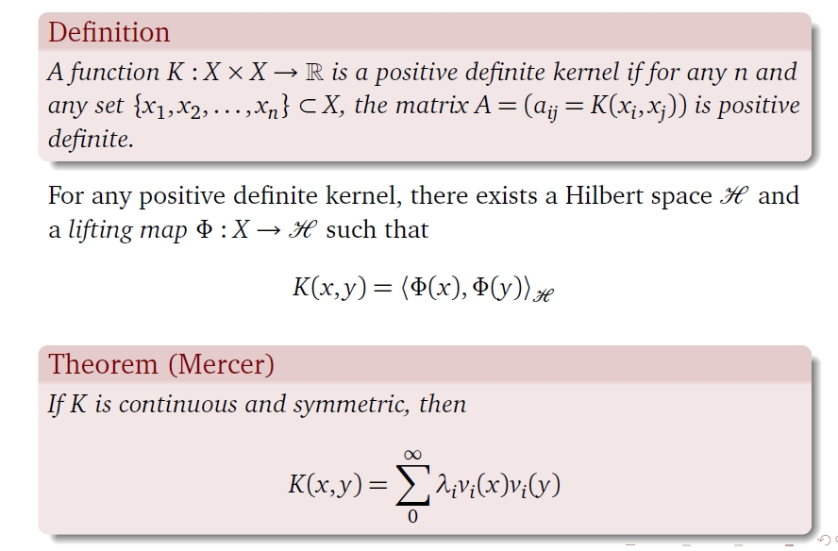
Kernels – General Conditions
Called the Gram Matrix.
A is positive semidefinite if zAz^{T} >0 for all nonzero z 2 R^{n}
In fact, no need to have an explicit representation of Á, only that K satisfies:

Slide 79
The kernel trick
Define a feature function φ(x) which maps items x into a higher-dimensional space.
We can then write a linear function in this space in its dual form:
f(x) = ∑_{d} α_{d} φ(x_{d})∙φ(x) = ∑_{d} α_{d} K(x_{d}∙x)
Dual representation: We don’t need to learn w in this higher-dimensional space. It is sufficient to evaluate K(x_{i}, x_{j})
The kernel function K(x_{i}, x_{j}) = φ(x_{i})φ(x_{j}) computes the inner product between the φ(x_{i}) and φ(x_{j})
Kernel Trick: it is possible to compute K(x_{i}, x_{j}) = φ(x_{i})φ(x_{j}) in the original space.

Slide 80
Properties of the kernel matrix K
K is symmetric:
K_{ij} = k(x_{i}, x_{j}) = φ(x_{i})φ(x_{j}) = k(x_{j}, x_{i}) = K_{ji}
K is positive semi-definite (∀ vectors v: v^{T}Kv ≥0):
Proof:

Slide 81
Polynomial kernels
Linear kernel: k(x, z) = xz
Polynomial kernel of degree d: k(x, z) = (xz)^{d} (only dth-order interactions)
Polynomial kernel up to degree d: k(x, z) = (xz + c)^{d} (c>0) (all interactions of order d or lower)

Slide 82
Constructing New Kernels
You can construct new kernels k’(x, x’) from existing ones:
Multiplying k(x, x’) by a constant c: k’(x, x’) = ck(x, x’)
Multiplying k(x, x’) by a function f applied to x and x’: k’(x, x’) = f(x)k(x, x’)f(x’)
Applying a polynomial (with non-negative coefficients) to k(x, x’): k’(x, x’) = P( k(x, x’) ) with P(z) = ∑_{i} a_{i}z^{i} and a_{i}≥0
Exponentiating k(x, x’): k’(x, x’) = exp(k(x, x’))

Slide 83
Constructing New Kernels (2)
You can construct k’(x, x’) from k₁(x, x’), k₂(x, x’) by:
Adding k₁(x, x’) and k₂(x, x’): k’(x, x’) = k₁(x, x’) + k₂(x, x’)
Multiplying k₁(x, x’) and k₂(x, x’): k’(x, x’) = k₁(x, x’)k₂(x, x’)
Also:
If φ(x) ∈ R^{m} and k_{m}(z, z’) a valid kernel in R^{m}, k(x, x’) = k_{m}(φ(x), φ(x’)) is also a valid kernel
If A is a symmetric positive semi-definite matrix, k(x, x’) = xAx’ is also a valid kernel
In all cases, it is easy to prove these directly by construction.

Slide 84
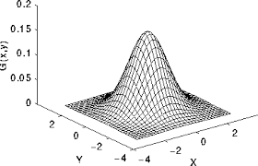
Gaussian Kernel (aka radial basis function kernel)
k(x, z) = exp(−(x − z)^{2/c}）
(x − z)²: squared Euclidean distance between x and z
c = σ²: a free parameter
very small c: K ≈ identity matrix (every item is different)
very large c: K ≈ unit matrix (all items are the same)
k(x, z) ≈ 1 when x, z close
k(x, z) ≈ 0 when x, z dissimilar

Slide 85
Gaussian Kernel
k(x, z) = exp(−(x − z)^{2/c}）
Is this a kernel?
k(x, z) = exp(−(x − z)²/2σ²）
= exp(−(xx + zz − 2xz)/2σ²）
= exp(−xx/2σ²）exp(xz/σ²) exp(−zz/2σ²）
= f(x) exp(xz/σ²) f(z)
exp(xz/σ²) is a valid kernel:
xz is the linear kernel;
we can multiply kernels by constants (1/σ²)
we can exponentiate kernels
Unlike the discrete kernels discussed earlier, here you cannot easily explicitly blow up the feature space to get an identical representation.

Slide 86
Kernels Over (Finite) Sets
X, Z: subsets of a finite set D with |D| elements
k(X, Z) = |X∩Z| (the number of elements in X and Z) is a valid kernel:
k(X, Z) = φ(X)φ(Z) where φ(X) maps X to a bit vector of length |D|
(ith bit: does X contains the i-th element of D?).
k(X, Z) = 2^{|X∩Z|} (the number of subsets shared by X and Z) is a valid kernel:
φ(X) maps X to a bit vector of length 2^{|D|}
(i-th bit: does X contains the i-th subset of D?)

Slide 87
Summary – Kernel Based Methods
A method to run Perceptron on a very large feature set, without incurring the cost of keeping a very large weight vector.
Computing the weight vector can be done in the original feature space.
Notice: this pertains only to efficiency: the classifier is identical to the one you get by blowing up the feature space.
Generalization is still relative to the real dimensionality (or, related properties).
Kernels were popularized by SVMs but apply to a range of models, Perceptron, Gaussian Models, PCAs, etc.

Slide 88
Efficiency-Generalization Tradeoff
There is a tradeoff between the computational efficiency with which these kernels can be computed and the generalization ability of the classifier.
For example, using such kernels the Perceptron algorithm can make an exponential number of mistakes even when learning simple functions. [Khardon,Roth,Servedio,NIPS’01; Ben David et al.]
In addition, computing with kernels depends strongly on the number of examples. It turns out that sometimes working in the blown up space is more efficient than using kernels. [Cumby,Roth,ICML’03]

Slide 89
Explicit & Implicit Kernels: Complexity
Is it always worthwhile to define kernels and work in the dual space?
Computationally: [Cumby,Roth 2003]
Dual space – t₁ m² vs, Primal Space – t₂ m
Where m is # of examples, t₁, t₂ are the sizes of the (Dual, Primal) feature spaces, respectively.
Typically, t₁ << t₂, so it boils down to the number of examples one needs to consider relative to the growth in dimensionality.
Rule of thumb: a lot of examples → use Primal space
Most applications today: People use explicit kernels. That is, they blow up the feature space explicitly.

Slide 90
Kernels: Generalization
Do we want to use the most expressive kernels we can?
(e.g., when you want to add quadratic terms, do you really want to add all of them?)
No; this is equivalent to working in a larger feature space, and will lead to overfitting.
Here is a simple argument that shows that simply adding irrelevant features does not help.

Slide 91
Kernels: Generalization(2)
Given: A linearly separable set of points S={x₁,…x_{n}} 2 R^{n} with separator w 2 R^{n}
Embed S into a higher dimensional space n’>n , by adding zero-mean random noise e to the additional dimensions.
Then w’ ¢ x’= (w,0) ¢ (x,e) = w ¢ x
So w’ 2 R^{n}’ still separates S.
We will now look at °/||x|| which we have shown to be inversely proportional to generalization (and mistake bound).
γ (S, w’)/||x’|| = min_{S} w’^{T} x’ / ||w’|| ||x’|| =
min_{S} w^{T} x /||w|| ||x’|| < γ (S, w’)/||x||
Since ||x’|| = ||(x,e)|| > ||x||
The new ratio is smaller, which implies generalization suffers.
Intuition: adding a lot of noisy/irrelevant features cannot help

Slide 92
Conclusion- Kernels
The use of Kernels to learn in the dual space is an important idea
Different kernels may expand/restrict the hypothesis space in useful ways.
Need to know the benefits and hazards
To justify these methods we must embed in a space much larger than the training set size.
Can affect generalization
Expressive structures in the input data could give rise to specific kernels, designed to exploit these structures.
E.g., people have developed kernels over parse trees: corresponds to features that are sub-trees.
It is always possible to trade these with explicitly generated features, but it might help one’s thinking about appropriate features.

Slide 93
Functions Can be Made Linear
Data are not linearly separable in one dimension
Not separable if you insist on using a specific class of functions
Representation
x

Slide 94
Blown Up Feature Space
Data are separable in <x, x²> space
x²
x

Slide 95
Multi-Layer Neural Network
Multi-layer network were designed to overcome the computational (expressivity) limitation of a single threshold element.
The idea is to stack several
layers of threshold elements,
each layer using the output of
the previous layer as input.
Multi-layer networks can represent arbitrary functions, but building effective learning methods for such network was [thought to be] difficult.
activation
Output
Hidden
Input

Slide 96
Basic Units
Linear Unit: Multiple layers of linear functions o_{j} = w ¢ x produce linear functions. We want to represent nonlinear functions.
Need to do it in a way that
facilitates learning
Threshold units: o_{j} = sgn(w ¢ x)
are not differentiable, hence
unsuitable for gradient descent.
The key idea was to notice that the discontinuity of the threshold element can be represents by a smooth non-linear approximation: o_{j} = [1+ exp{-w ¢ x}]⁻¹
(Rumelhart, Hinton, Williiam, 1986), (Linnainmaa, 1970) , see: http://people.idsia.ch/~juergen/who-invented-backpropagation.html )
activation
Output
w²_{ij}
Hidden
w¹_{ij}
Input

Slide 97
Model Neuron (Logistic)
Us a non-linear, differentiable output function such as the sigmoid or logistic function
Net input to a unit is defined as:
Output of a unit is defined as:
1
2
T
7
3
4
5
6

Slide 98
Learning with a Multi-Layer Perceptron
It’s easy to learn the top layer – it’s just a linear unit.
Given feedback (truth) at the top layer, and the activation at the layer below it, you can use the Perceptron update rule (more generally, gradient descent) to updated these weights.
The problem is what to do with
the other set of weights – we do
not get feedback in the
intermediate layer(s).
activation
Output
w²_{ij}
Hidden
w¹_{ij}
Input

Slide 99
Learning with a Multi-Layer Perceptron
The problem is what to do with
the other set of weights – we do
not get feedback in the
intermediate layer(s).
Solution: If all the activation
functions are differentiable, then
the output of the network is also
a differentiable function of the input and weights in the network.
Define an error function (multiple options) that is a differentiable function of the output, that this error function is also a differentiable function of the weights.
We can then evaluate the derivatives of the error with respect to the weights, and use these derivatives to find weight values that minimize this error function. This can be done, for example, using gradient descent .
This results in an algorithm called back-propagation.
activation
Output
w²_{ij}
Hidden
w¹_{ij}
Input

